Slide 1


The Hitchhiker’s Guide to Probabilistic Data Structures
Using RedisBloom’s Count-Min Sketch
Notes:
Hello! My name is Jack Pines and today I’ll be your guide through the universe of probabilistic data structures. Specifically, we’ll look at those structures found in RedisBloom and dive into the Count-Min Sketch. This can get a little wonky but I promise that I’ll focus in on the business value of having this tool in your back pocket.
<tap>I’ll try to avoid a lot of techno-babble but if it’ll make you more comfortable then feel free to slip this in your ear.

Slide 2


You shouldn’t need your towel. (But it’s always good to have one.)
Notes:
Now don't panic. There'll be no need for your towels. (You do have your towels, right?)
Ok, then, let's jump right in!

Slide 3


Oh…hello…. What’s a probabilistic data structure? *sigh* I’ll simplify it for you…
Space-saving solution to gaining big data insights
Represents a measurable aspect of the data, not the data itself
Fast read/write operations
Typically uses hashing (TB alert)
Trades accuracy for speed and space
Has certain guarantees for accuracy
Often supports merging
Good enough for rocket science? (sometimes)
Notes:
Oh, Marvin! Wonderful! What this dry topic needs is your cheery disposition. (He is useful, though.)
What Marvin was going to say is that a probabilistic data structure is...
<tap7>...merging, and other set operations, where the former enables parallel operations on different sketches to be merged later.
Rockets can emit a lot of telemetry. If you're space traffic controller trying to track all the rockets in the universe, then it might be nice to get an early alert of some anomalous behavior. Rather than processing all the data constantly, we can increment counters and alert upon a high count for further investigation of the raw data.

Slide 4


Zaphod says: “When you want something done poorly, I’m our man!”
Notes:
Um, yeah. Let's not delegate this to Zaphod.
That said, everyone else here is a professional so you'll have seen this chart before. As I noted, our trade-off is that we get a time & space complexity of O(1) while losing some precision. If you can do something faster, that both saves and makes money. If you can also cut your costs, it’s a serious benefit to the business and I’ll demonstrate why quality shouldn’t be a blocking concern.

Slide 5

So, what’s the probabilistic part?
There is some probability of error, false positives, overcounts, etc.
This probability can be controlled for:
Quality and/or number of hashing algorithms used
Width (constant) of the data storage
Notes:
(Read the screen)
The good news is that RedisBloom handles this for us by allowing us to specify the amount of error we're willing to tolerate.

Slide 6
Who is this character? RedisBloom who?
Redis is an open-source, in-memory data structure store
RedisBloom is a Redis Module
Redis Modules allow for extending Redis functionality via a public API
Providing four probabilistic data structures: a scalable Bloom filter, a cuckoo filter, a count-min sketch, and a top-k
Notes:
Well, Zaphod...
...and...
So, RedisBloom adds new functionality to Redis by...

Slide 7
What do you want to know?
Come again?
Bloom & Cuckoo Filters – Is the element a member of the set?
Count-Min Sketch – How many of an element is in a stream?
Top-K – What are the k most frequently seen elements?
Each of these extends the prior’s concept.
Allow me (to under-stand it for you).
Notes:
<tap>
Thanks, Marvin. I'll take it from here. It boils down to...

Slide 8

Bloom Filter
X
1
1
1
1
X
1
indexes -> hf1(value) % array.Length, hf2(value) % array.Length, hf3(value) % array.Length
“foo” -> 3, 5, 7
Is “foo” in the set? -> 3, 5, 7
Probably…
“bar” -> 3, 6, 9
Is “baz” in the set? -> 3, 0, 8
Definitely not!
Is “qux” in the set? -> 3, 6, 7
Probably…
Notes:
Marvin is going to demonstrate a Bloom Filter, which is represented by a bit array and several hashing functions. For the techno-babble adverse, think of hashing functions as a way of creating a lookup in a dictionary or catalog, like the Dewey Decimal System, to find a wealth of information like a book or a definition quickly. It’s unimportant here to know any details about hashing functions beyond that.
Credit: https://youtu.be/Z9_wrhdbSC4

Slide 9
Count-Min Sketch
1
2
17
0
10
1
1
7
indexes -> hf1(value) % array.Length, hf2(value) % array.Length, hf3(value) % array.Length
1
12
1
0
5
Index_{hf1} -> hf1(value) % array.Length, Index_{hf2} -> hf2(value) % array.Length, Index_{hf3} -> hf3(value) % array.Length
Add “foo” -> 3, 5, 7
How many “foo” have we seen? -> 3, 5, 7
⌊1, 1, 1⌋ = 1
Add “bar” -> 3, 6, 9
How many “bar” have we seen? -> 3, 6, 9
⌊2, 1, 1⌋ = 1
How many “qux” have we seen? -> 3, 6, 7
⌊2, 1, 1⌋ = 1
We add another of 9x “foo”s, 4x “bar”s, and 2x “qux”s from the stream…
How many “foo” have we seen? -> 3, 5, 7
⌊17, 10, 12⌋ = 10
How many “bar” have we seen? -> 3, 6, 9
⌊17, 7, 5⌋ = 5
How many “qux” have we seen? -> 3, 6, 7
⌊17, 7, 12⌋ = 7
How many “baz” have we seen? -> 3, 0, 0
⌊17, 0, 0⌋ = 0
Notes:
Hold on, Marvin. Before I let Marvin demonstrate the Count-Min Sketch, let’s discuss why it’s important.
Typically, if we want to count things, we'd use a hash map and increment the value at a given key. However, you can see how counting millions of objects could result in serious memory pressure.
Often, we don't store the object but an ID representing the object and a counter. This helps to an extent but if we scale to billions, then we suddenly find ourselves using GBs of RAM just for the data.
We can do a lot better if we use a Count-Min Sketch and we can even have a reasonable probability of correctness.
You'll see that I've carried over the array and hashing functions from the Bloom Filter. That's because this extends that mechanism by adding rows for each of the hashing functions and storing an integer rather than a bit.
Now, go ahead and demonstrate, Marvin…
...We've seen at most...
I'm not going to go into the math (HUSH, MARVIN) but if you use 10 good hashes and array widths of 2,000, the probability of not having an error is 99.9% and the error rate is 0.1%. (This is the percentage of total increments, not of unique items).
In real numbers, that means if you add 1 million unique items, on average, each item will receive a value of 500 (1M/2K). Though that seems disproportionate, this falls well within our error rate of 0.1%, which is 1,000 on 1 million items.(1)
This gets us down to 78KB of RAM
- credits:
(1)https://redislabs.com/blog/how-to-get-started-with-probabilistic-data-structures-count-min-sketch/

Slide 10
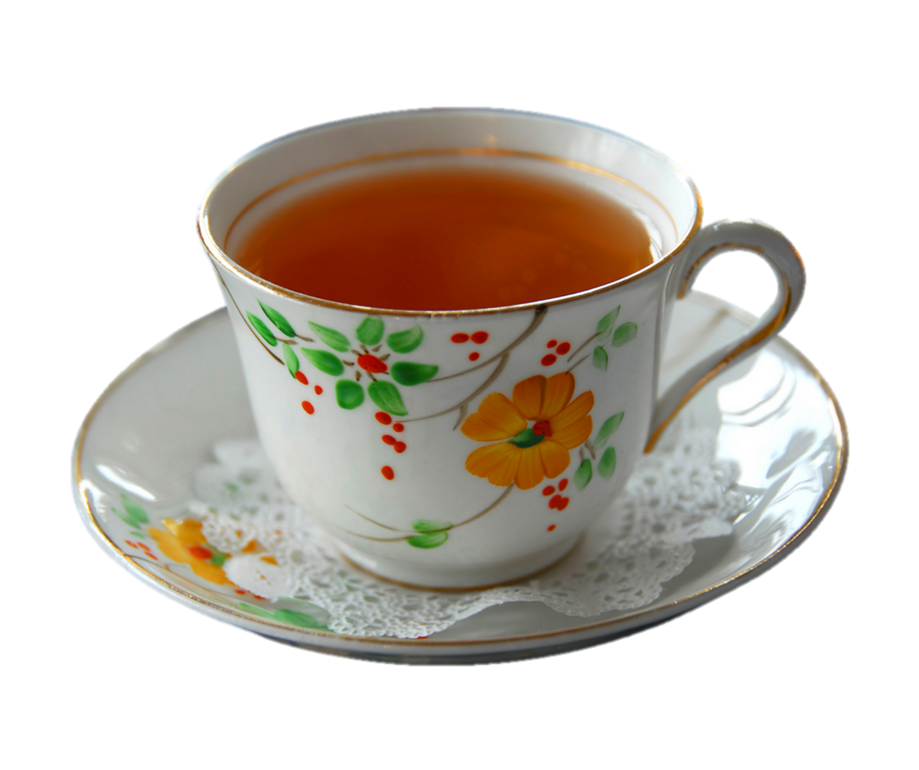
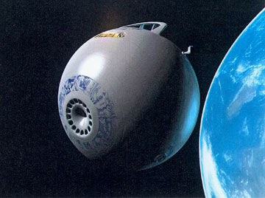
Demo Time
Notes:
If you all would like, I’d be happy to do a brief demo of the count-min sketch in action. I can go into as much or as little detail as folks would like.
To do so, then, we'll hitch a ride on the Heart of Gold, the marvelous ship you see before you. Grab a cup of tea and enjoy the ride.

Slide 11

No petunias or whales were harmed in the making of this presentation.
Thumbing: https://tinyurl.com/y6lhvyrh
Sulking Marvin: https://tinyurl.com/y6k29zt4
Heart of Gold: https://tinyurl.com/y569t6cy
Brownian fluid: https://tinyurl.com/y4jna8bd
Zaphod asks: https://tinyurl.com/y5jjjh8y
Whale & Petunia: https://tinyurl.com/y2u56dam
Zaphod says: https://tinyurl.com/y24psm7w
Time, Cost, Quality Triangle: https://tinyurl.com/y2lpekw6
Marvin: https://tinyurl.com/y5jwqc8z
Don’t Panic: https://tinyurl.com/zzvlysg
Babel Fish: https://tinyurl.com/yyrja93j
Notes:
...though I'm sure Marvin's feelings were hurt.

Slide 12

Hope you enjoyed the trip!

